Slide 1
Mesh Algorithms
Ram Krishna Dahal
Asst. Professor
Central Department of computer science and IT, TU

Slide 2
Computation Model
A mesh is an a × b grid in which there is a processor at each grid poin
The edges are bi-directional communication links, i.e. two separated uni-directional links
Each processor can be labeled with a tuple (i, j)
Each processor has some local memory, and can perform basic operations

Slide 3
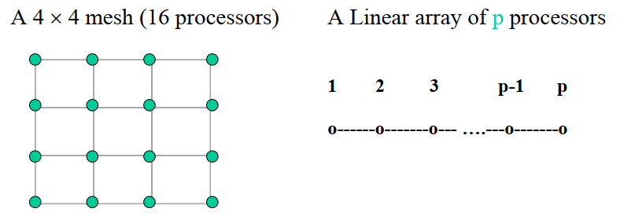
There is a global clock which synchronize all processors
We only consider square meshes here, i.e. a = b, and linear array

Slide 4
Packet Routing
Primitive Inter-processor Communication Operation – packet routing
A packet contains data + source processor + destination processor
A link can handle only one packet at one unit time
A processor may receive multiple packets (from different links) and send multiple packets (to different links) at the same time

Slide 5
A processor may queue some packets in its local storage
Each processor uses the same packet routing algorithm
Partial Permutation Routing (PPR) is a special case of general routing problem. In PPR, each processor is the origin (and destination) of at most one packet.
The performance of an algorithm is measured by run time, i.e. time to complete all operations, and maximum queue length, i.e. the maximum number of packets in a processor queue.

Slide 6
The time taken by any packet to reach its destination is dictated by the distance of the chosen path between the packet’s origin and destination and the amount of time (referred to as delay) the packet spends waiting in queues.
A Packet Routing Algorithm is specified by the path to be taken by each packet and a priority scheme.
Run Time is the time taken by the last packet to reach its destination

Slide 7
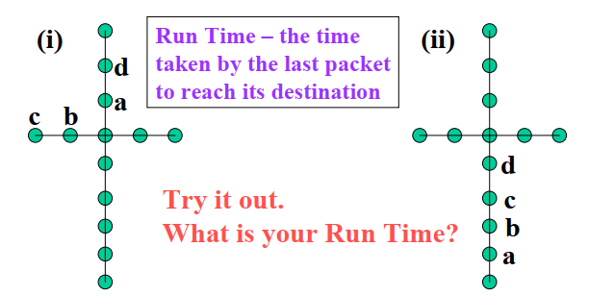
Example
Consider the packets a, b , c and d in (i). Final destinations are in (ii). Each packet takes the shortest path to its destination.
(a) Use FIFO Priority Scheme (If two packets reached a node at the same time, there is a tie. This can be broken arbitrary.)

Slide 8
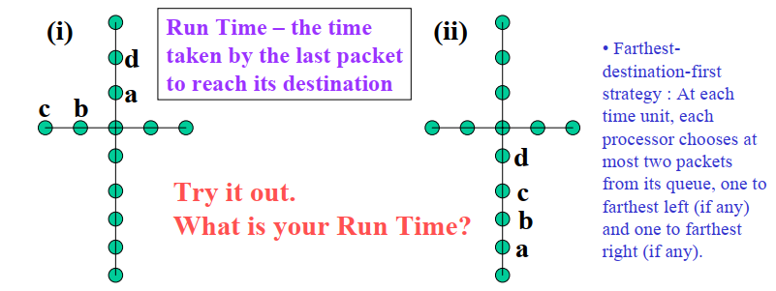
(b) Use Farthest-destination-first Scheme (If two packets have the same destination, there is a tie. This can be broken arbitrary.)

Slide 9
Packet routing on a linear array of p processors
Problem 1 : At most one packet originated from each processor. (with arbitrary destinations)
Problem 1 can be solved in <= p – 1 steps.
Every processor starts to send packet using the shortest route. There is no contention for any link. The maximum distance is p – 1 links.

Slide 10
Problem 2 : Each processor is the destination for exactly one packet. (can have multiple packets starting from a single origin) Note : A processor may have multiple packets to be routed to multiple processors.
Farthest-destination-first strategy : At each time unit, each processor chooses at most two packets from its queue, one to farthest left (if any) and one to farthest right (if any).

Slide 11
By using the farthest-destination-first strategy, the time needed for a packet stating at processor i to reach its destination is no more than Max (p-i,i-1)
Informal Proof : Just consider only packets that are moving from left to right. (same for those moving from right to left)
(1) A packet to processor p cannot be delayed according to the strategy, so, it will reach destination at p-i units.
(2) A packet to processor p-1 can only be delayed by packet to p, so it will reach destination at p-1-i units + 1 delayed unit <= p-i units
(3) and so on.
Problem 2 can be solved in <= p – 1 steps using the farthest-destination-first strategy

Slide 12
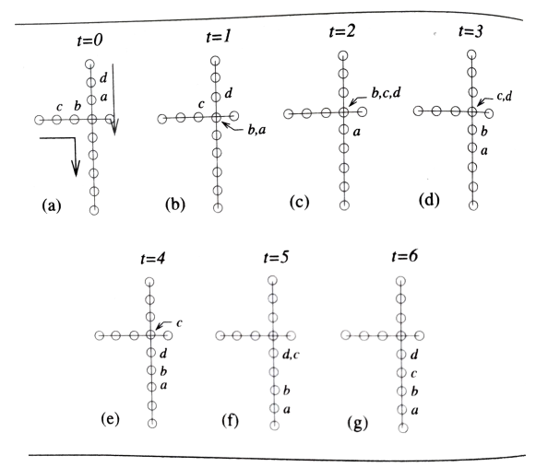
Example – packet routing

Slide 13
Packet routing (PPR) on a Mesh
Assume p × p processors Algorithm PPR: Let q be an arbitrary packet with (i,j) as its origin and (u,v) as its destination. Phase 1 : Travel along column j to row u Phase 2 : Travel along row u to its destination (u,v)

Slide 14
Running time analysis for Algorithm PPR
The lower bound is 2(p-1) steps, i.e. from (1,1) to (p,p) (opposite corners)
Phase 1 can be done in (p-1) steps (by problem 1 above)
Phase 2 can be done in (p-1) steps (by problem 2 above)
Total : 2(p-1) steps → optimal algorithm

Slide 15
Problem : in the worst case, the queue size is p/2. i.e. In each time unit, 2 packets arrive and only one can be sent out There are at most p packets in one column → may need to queue up to p/2 packets

Slide 16
Fundamental Algorithms
Broadcasting problem : To broadcast a message to all processors Assume a processor can duplicate message. Phase 1 : Send the message along the row. Phase 2 : For each processor in the row, send message along its column. Total time <= 2(p-1) = O(p)

Slide 17
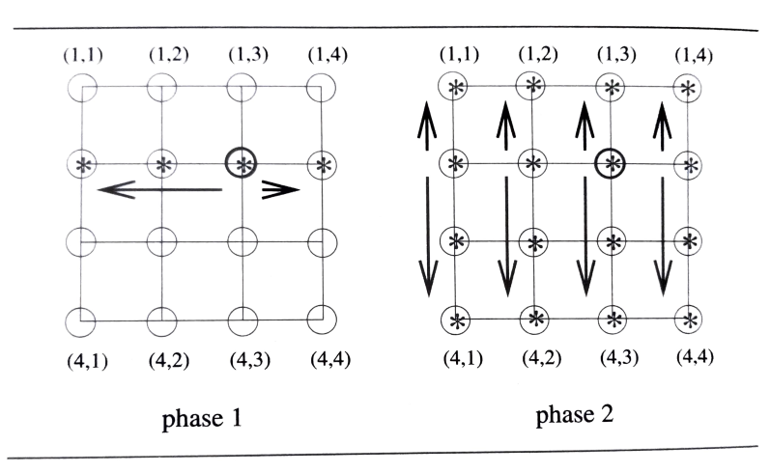
Broadcasting on a mesh

Slide 18
Prefix computation on mesh
Prefix computation problem for p × p mesh; Total time O(p)
Assume there is a number in each processor, i.e. p² numbers {x_{1,1}, x_{1,2}, …, x_{1,p}, x_{2,1}, x_{2,2}, …, x_{2,p}, …, x_{p,1}, x_{p,2}, …, x_{p,p}}
Phase 1 : Each row i, compute prefix x_{i,1}, x_{i,1}⊕ x_{i,2}, …, x_{i,1}⊕ x_{i,2}⊕…⊕ x_{i,p}
Phase 2 : Compute prefix for number in column p. Assume final numbers in column p are α₁, α₂, …, α_{p}
Phase 3 : For each processor (i,p) in column, broadcast the number αi-1 to all other elements in same row i. The number α_{i-1}will be added to each number in row i.

Slide 19
Indexing scheme
Possible orderings
Row major
Column major
Snake like row major
Block wise snake like row major

Slide 20
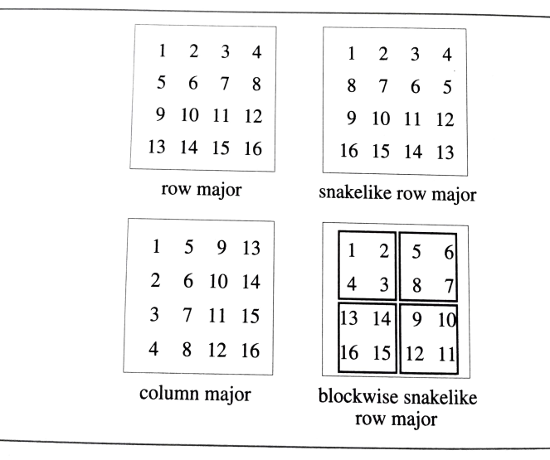
Examples of indexing scheme

Slide 21
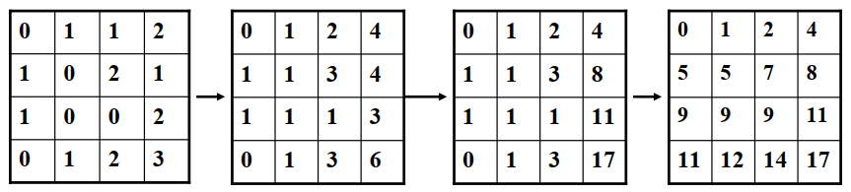
Example – prefix computation on a mesh
Assume each small square is a processor in 4 x 4 mesh

Slide 22
Data Concentration
In a p-processor interconnection network assume that there are d<p data items distributed arbitrarily with at most one data item per processor.
The problem of data concentration is to move the data into the first d processors of the network one data item per processor.
This problem is also known as packing.

Slide 23
Data Concentration
Data concentration on any network is achieved by first performing a prefix computation to determine the destination of each packet and then routing the packets using an appropriate packet routing algorithm.
In the case of a p-processor linear array, we have to move the data into the processors 1,2,.. . ,d. On a mesh, we might require the data items to move according to any indexing scheme of our choice.

Slide 24
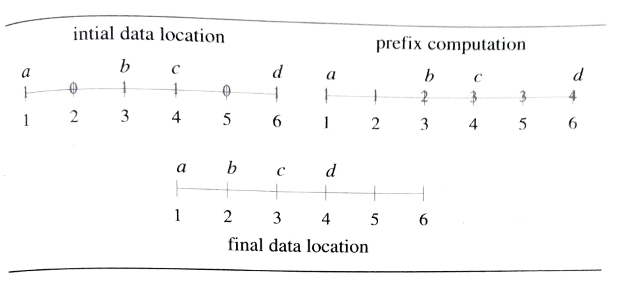
Data Concentration – on a linear array

Slide 25
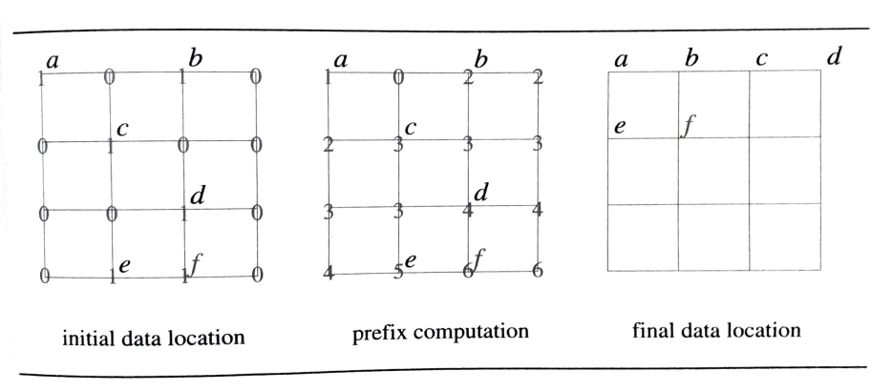
Data Concentration – on a mesh network

